Slide 1
BA840 Group 2
AI-Generated
Music
Copyright | Ownership | Ethics
Notes:
PRATEEK

Slide 2
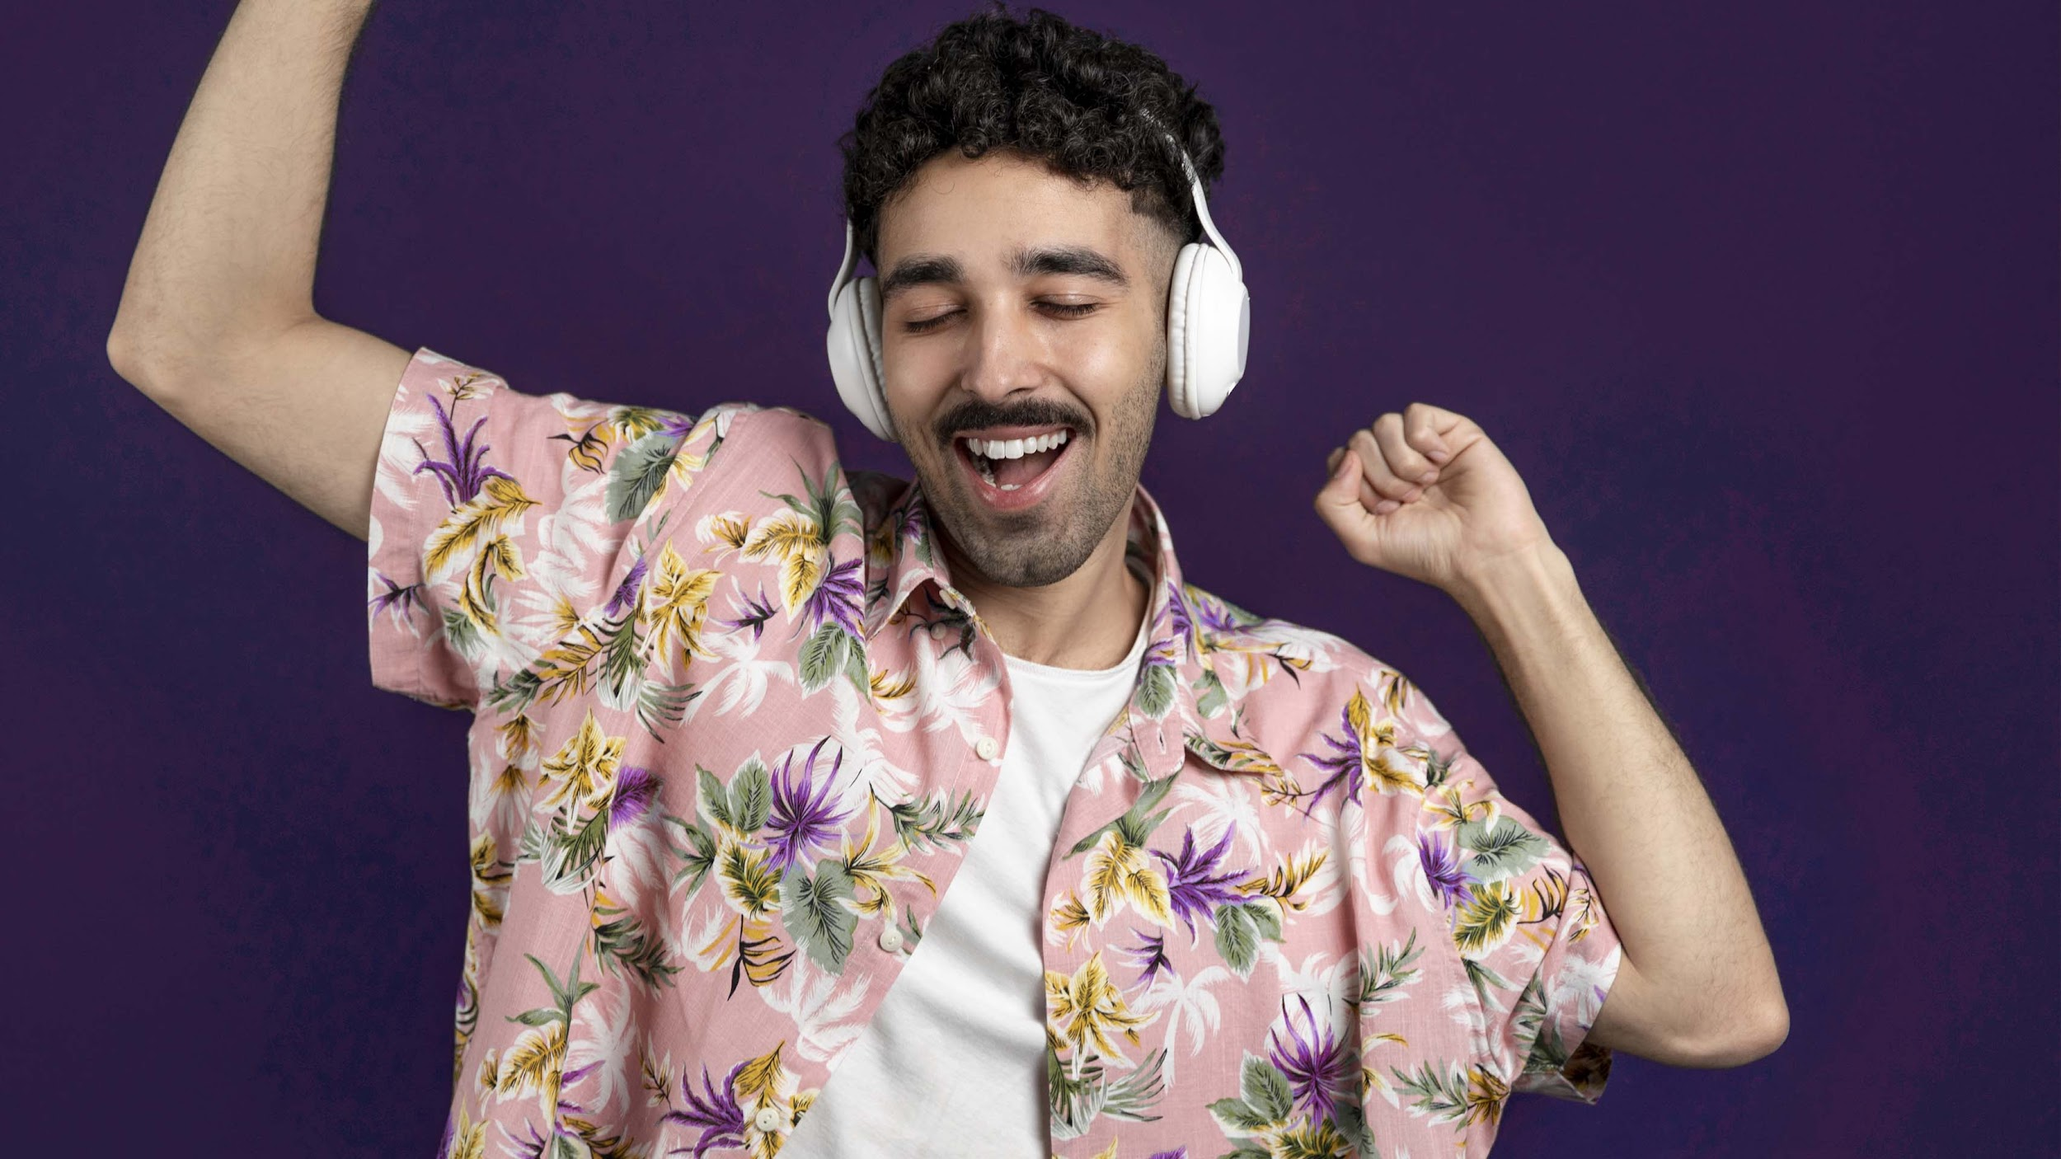
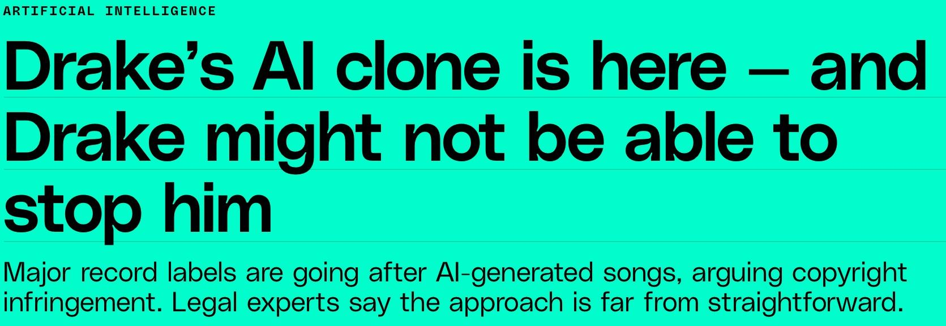
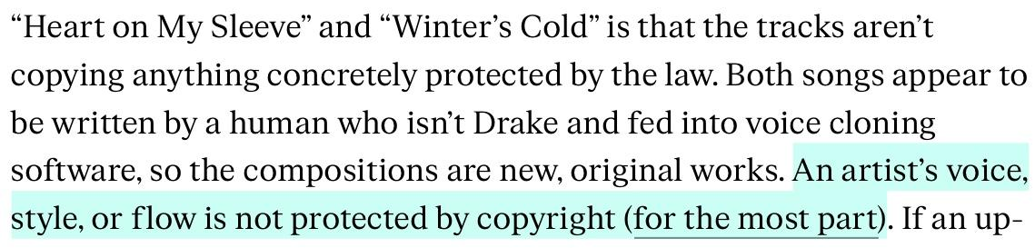

Slide 3
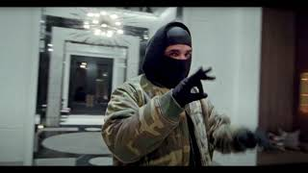
Let’s
Listen!
Drake AI Winter’s Cold

Slide 4
Uses of Generative AI in Music
Generative AI Music
Creative Use
Commercial Use
Licensed Use
Unlicensed Use
Notes:
ANISH Puthu

Slide 5
Decision Framework
01
02
03
04
05
06
Effort
Intent
How much effort was put into this?
Is your intent malicious or deception?
Monetization
Duration
Are you making money from this?
Is the entire song using this voice?
Similarity
Focus
How similar is the voice to the singer?
Is the voice the primary selling point?

Slide 6
Ethical Framework
Deontological
Intent | To not Deceive
Monetization | To not exploit someone for monetary gain
Focus | To create something bigger than the parts
Notes:
LOKI

Slide 7
Ethical Framework
Consequential
>
Creative Harm to Drake
Effort | Did it create more value than just the voice?
Duration | Impact on the listener’s experience
Similarity | Impact on the artist’s identity due to confusion

Slide 8

Let’s Apply it!
Intent | Not trying to Deceive
Monetization | It is being monetized
Effort | Value was created
Duration | Entire Song
Similarity | Exactly Same
Focus | Not the voice
Drake AI Winter’s Cold
Notes:
MEHUL

Slide 9
Let’s skip to the good part…….
Guides Decision Making
Considers both ethical perspectives
Saves Integrity of Artists
Notes:
SID BOOKENTERE

Slide 10
What could go wrong?
Context driven metrics
Specific cases could slip out
People might be able to break it

Slide 11
Future of AI in Music
Music would be democratized
Lower Barrier of Entry
Speedy Production
Notes:
SINDHURA (Uppala)

Slide 12
Future of AI in Music
Music would be democratized
Quantity over Quality
Similar Music,
No Creativity

Slide 13
Some questions for you to think
➡️ Does auto-tuning to sound like someone count as plagiarism?
➡️ Who owns someone’s voice?
➡️ What parts of the voice/singing style belongs to them?

Slide 14
Thanks!
Search
Home
Do you have any questions?
Library
Sindhura Uppalapati
Anish Puthuraya
Mehul Agarwal
Lokendra Badgujar
Siddharth Bookinkere
Prateek Naharia
REFERENCES-
https://www.theverge.com/2023/5/1/23703087/ai-drake-the-weeknd-music-copyright-legal-battle-right-of-publicity

